Slide 1

503106
ADVANCED WEB PROGRAMMING
CHAPTER 11: Authentication
LESSON 11 – Authentication

Slide 2
OUTLINE
Authentication
Storing Users in Your Database
Passport
Setting Up Facebook App
Setting Up Passport
Role-Based Authorization
References

Slide 3
Authentication
Authentication Versus Authorization
Authentication refers to verifying users’ identities.
Authorization refers to determining what a user is authorized to access, modify, or view.
The Problem with Passwords
Third-Party Authentication
Third-party authentication takes advantage of the fact that pretty much everyone on the Internet has an account on at least one major service, such as Google, Facebook, Twitter, or LinkedIn. All of these services provide a mechanism to authenticate and identify your users through their service.

Slide 4
Storing Users in Your Database
Whether or not you rely on a third party to authenticate your users, you will want to store a record of users in your own database.
So let’s create a model for our users, models/user.js:
We need some way to map a user record to a third-party ID, so we have our own ID property, called authId. For example, a Facebook user might have an authId of facebook:525764102

Slide 5
Passport
Passport is a very popular and robust authentication module for Node/Express.
The detail that’s important to understand is that, with third-party authentication, your app never receives a password. That is handled entirely by the third party.
The whole process, then, relies on redirects.
When you use Passport, there are four steps that your app will be responsible for.

Slide 6
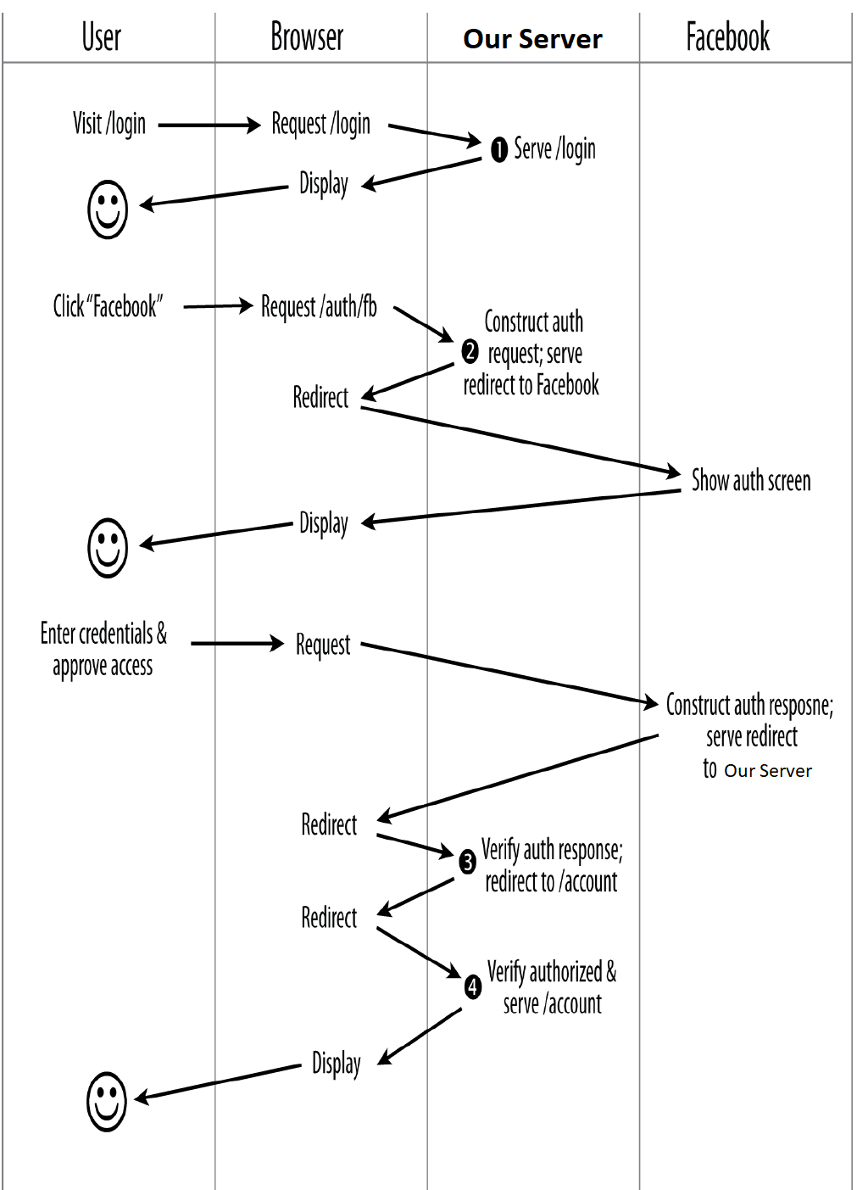
Passport

Slide 7
Setting Up Facebook App
To keep things simple, we’ll start with a single authentication provider. Arbitrarily, we’ll choose Facebook.
For Facebook authentication, you’ll need a Facebook app.
https://developers.facebook.com/apps

Slide 8
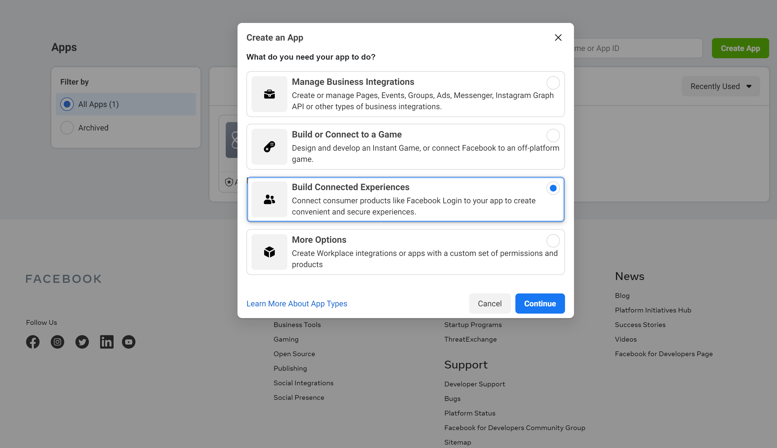
Setting Up Facebook App
Click on the create app link and choose “Build Connected Experience”

Slide 9
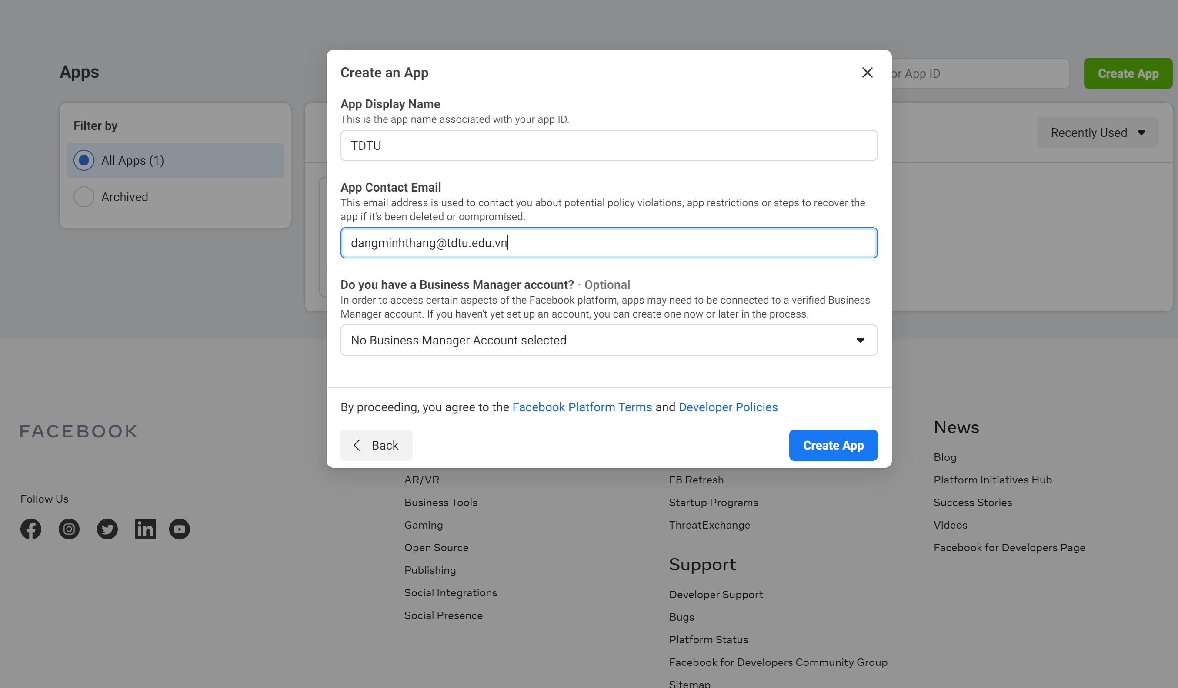
Setting Up Facebook App
You will need to enter the details in the following pop-up

Slide 10
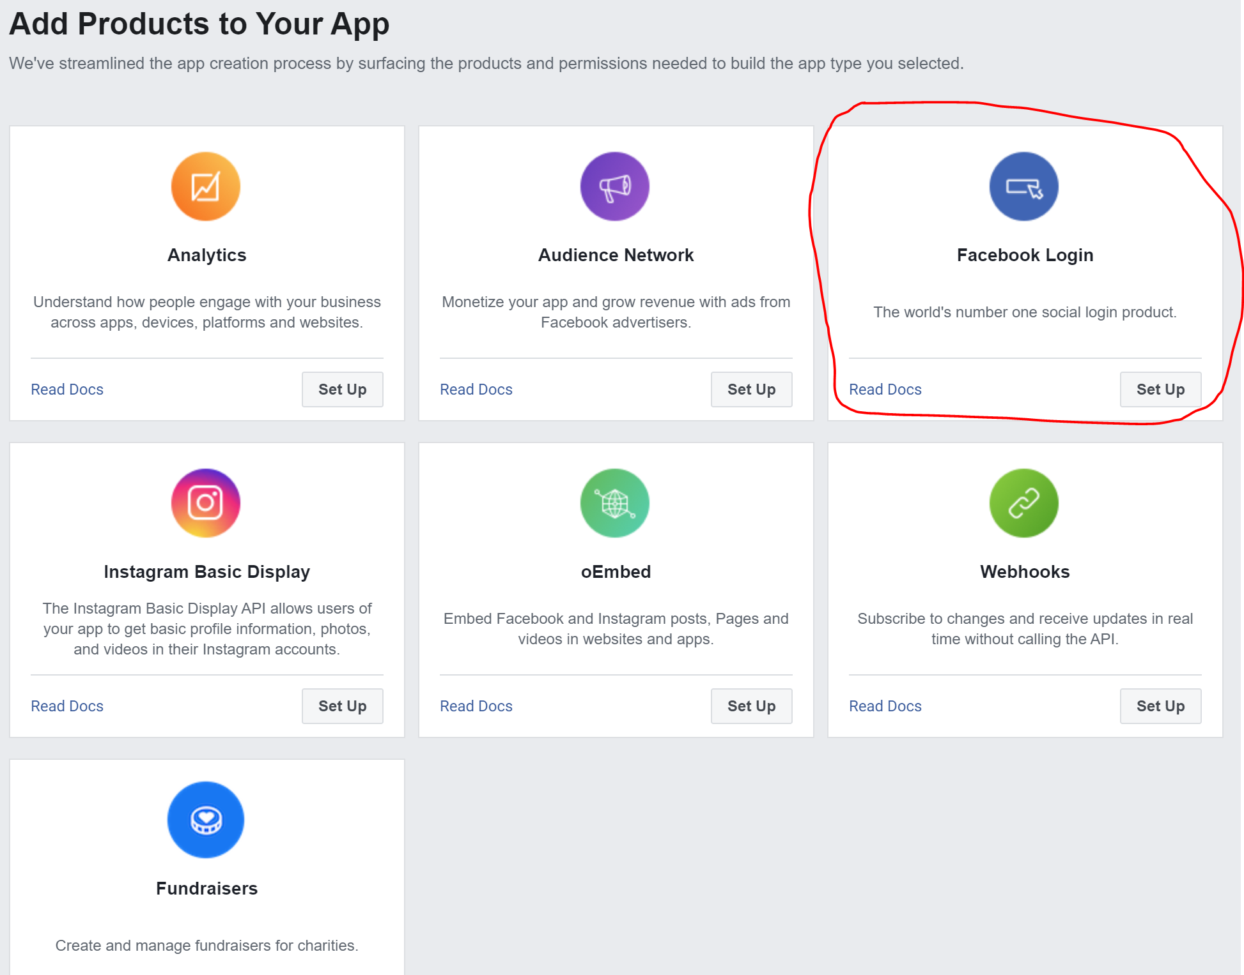
Setting Up Facebook App
After creating an app you need to add the product of Facebook, here we are going to use Facebook Login

Slide 11
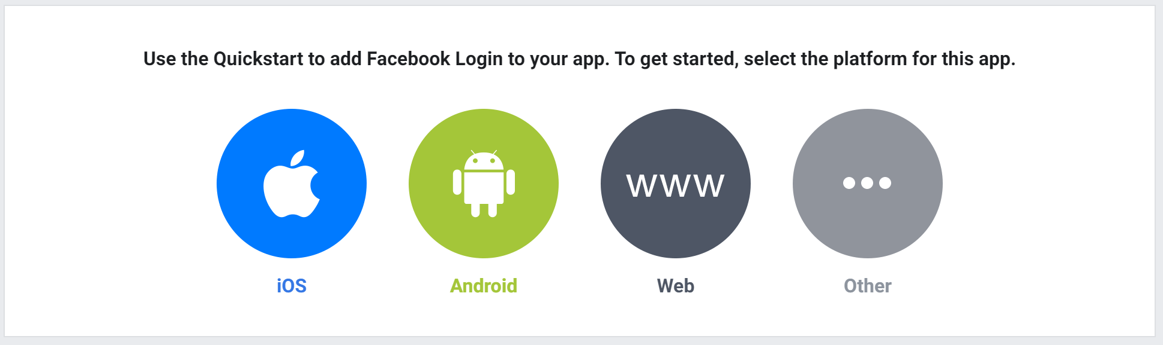
Setting Up Facebook App
After adding up the product you can now choose to have 'web' and while setting up the URL, you can simply write 'http://localhost:3000'

Slide 12
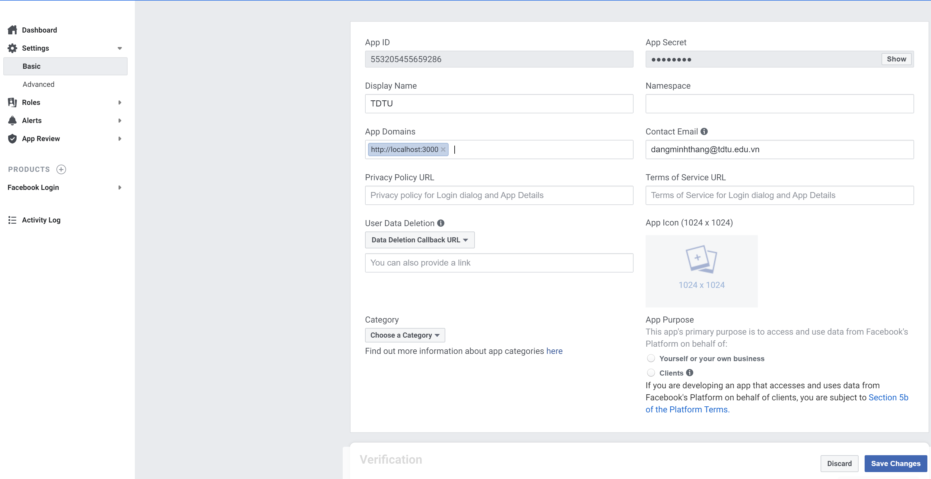
Setting Up Facebook App
After this go to tab 'MyApps' and select the App name. Select the 'Basic` from settings options in the sidebar as shown below. You can now copy your secret and ID from here

Slide 13
Setting Up Passport
Then let’s install Passport, and the Facebook authentication strategy:
npm install passport passport-facebook

Slide 14
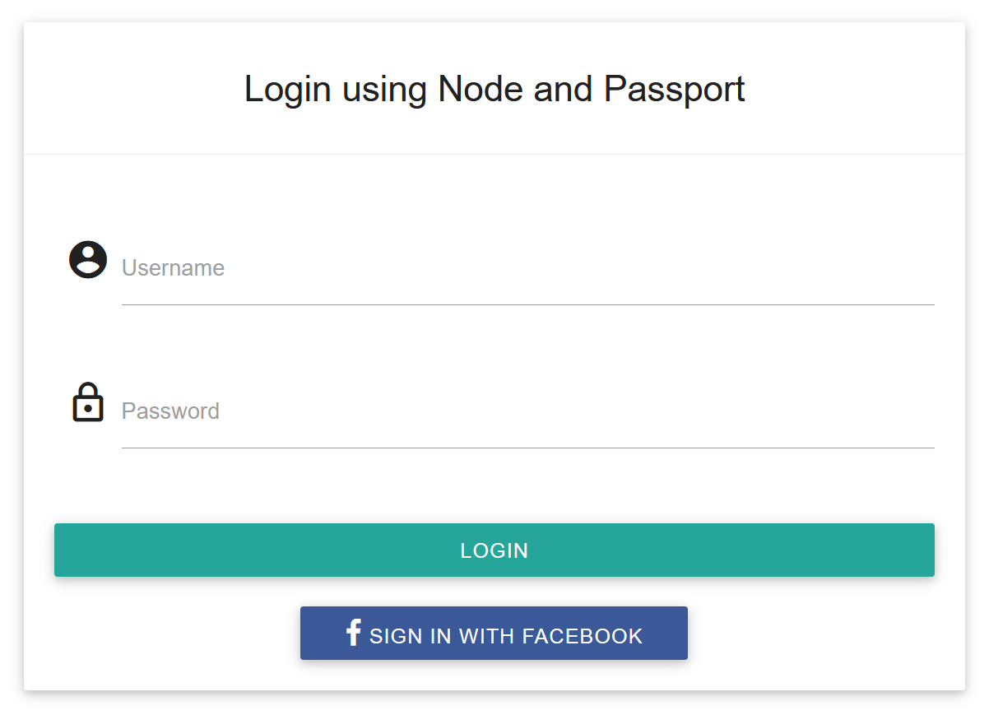
Setting Up Passport
Create a login page:

Slide 15
Setting Up Passport
Passport initialization:

Slide 16
Setting Up Passport
Passport configuration:

Slide 17
Setting Up Passport
Two routes are required for Facebook authentication.

Slide 18
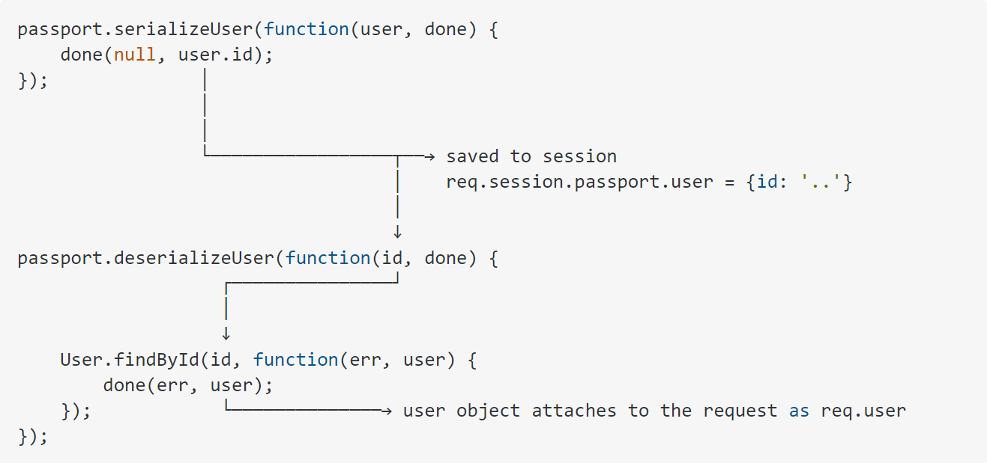
Setting Up Passport
In order to support login sessions, Passport will serialize and deserialize user instances to and from the session.

Slide 19
Setting Up Passport
Let’s look at our /dashboard to see how it checks to make sure the user is authenticated:

Slide 20
Role-Based Authorization
Let’s say we only want admins to see their admin pages.
Let’s create a function called adminOnly that will allow only admins:

Slide 21
References
http://www.passportjs.org/docs/

